Slide 1

RAPID APPLICATION DEVELOPMENT (RAD)

Slide 2
What is Rapid Application Development?
RAD is a software development methodology focused on developing applications in a very short time frame.
Considering the high level, RAD; It is an iterative software development technique in which the system is designed according to the needs using prototypes, case tools.
The RAD statement has recently become a commercial term for applications that can be designed and developed within 60 to 90 days.
But in reality, this statement refers to a software development process that involves application prototyping and progressive application development.
Although RAD has been around for 20 years, it is now as valid as it was first introduced.

Slide 3
PROBLEM
RAD SOLUTION
Development processes such as the Waterfall method produced results that did not meet user needs.
Development processes were very long and needs were changing until the system was completed
Before one stage of the development process was completed, the other stage could be passed.
Especially when a software process based on certain requirements was frozen at some point, the total development processes would be too long.
In 1986, Barry Boehm's summer appearance titled 'A Spiral Model in Software Development and Development' defined the concepts of prototyping and iterative development as the first default and focused on risk reduction.
In the late 1980s, Scott Shultz and James Martin brought together the concepts of prototyping and iterative development, introducing the RIPP (Rapid Iterative Production Prototyping) "Serial iterative development prototyping" method.
James Martin formulated the PIPP approach by further expanding it and published a book called RAD (Rapid Application Development) "Serial Application Development" in 1991.

Slide 4
Benefits
Increasing Speed:
As stated in the name, the main advantage of RAD is that it increases the speed of application development and shortens the project delivery time.
While the first version, which will be a light version, is designed and developed quickly, plans are made in the future versions regarding the advanced features that cannot be added to the software in the short term considering the time constraints.
Increased Quality:
Increased quality is one of the main objectives of the RAD methodology. The quality measure before RAD, perhaps more intuitively, was a rating of how well an customization fits and less hitches when an application is complete.
According to RAD, the quality depends on the extent to which the completed work meets the user needs and how low the maintenance and repair costs are.

Slide 5
Drawbacks
Decreased Features
Because some of the features that will be put into the system due to time constraints can be left to the next versions, RAD can produce solutions with less options in the first versions of the system compared to classical methods.
This should be managed by establishing open dialogues with the customer as quickly as possible, and exchanging information on the system and timing to be delivered.
Decreased Scalability
Since RAD primarily focuses on developing a core prototype that will cover the entire system when processes are completed, the delivered solution may be incomplete compared to the solution originally designed as the entire system in terms of scalability.

Slide 6
Basic Elements of RAD
Prototyping
RAD basically relies on developing the first system prototype that reveals user requirements and will be the main starting point for the development of the entire system. The aim is to prepare a version that is lightweight in terms of features but can be finished as days in a very short time if possible.
Iterative Development
Iterative development means increasing the qualities of the system as the versions progress over the small development periods. Each version is reviewed with the customer to determine the requirements for the next version.
Version Planning
Version planning is the process of postponing some features to be realized in future versions in order to be able to release the version being studied on time.
Team Members
RAD methodology; recommends working with small teams of experienced, versatile, highly motivated staff who can play different roles.
Management Approach
An active and internal management approach is vital for reducing the risks that lead to prolonged development processes, customer misunderstandings, and reducing time limits.

Slide 7
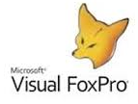

What is FoxPro?
It is a program of Microsoft company.
Database applications can be developed easily.
Design time and run time is very fast.
According to non-server databases, rushmore technology is used, which strengthens performance by 10 times.
Rushmore technology is a data access technique that enables very efficient access to record sets.
Rushmore query optimization efficiently uses indexes to quickly find a series of records.
Encoding can be done with the first 4 characters of all commands or functions.

Slide 8
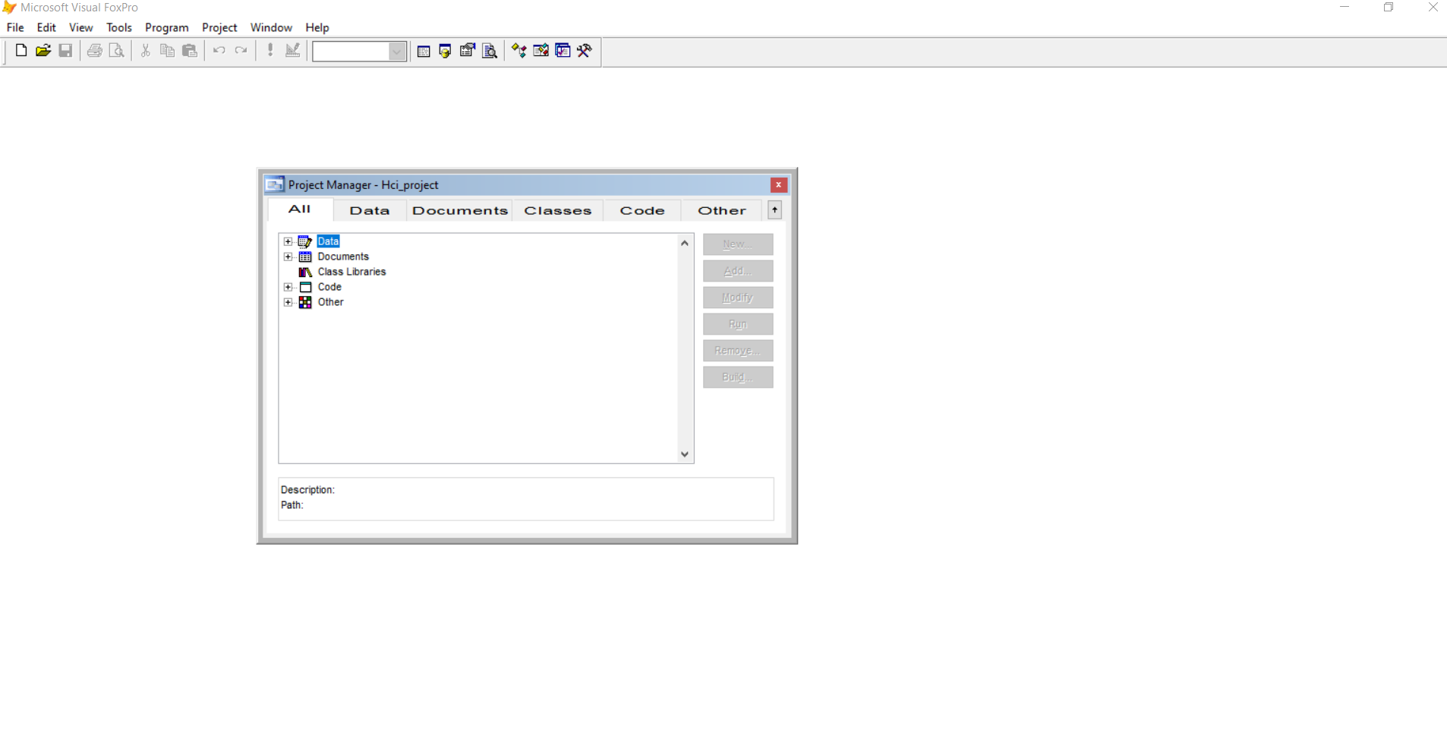
Working Environment
The workspace where we will have the option to choose actions is shown.

Slide 9
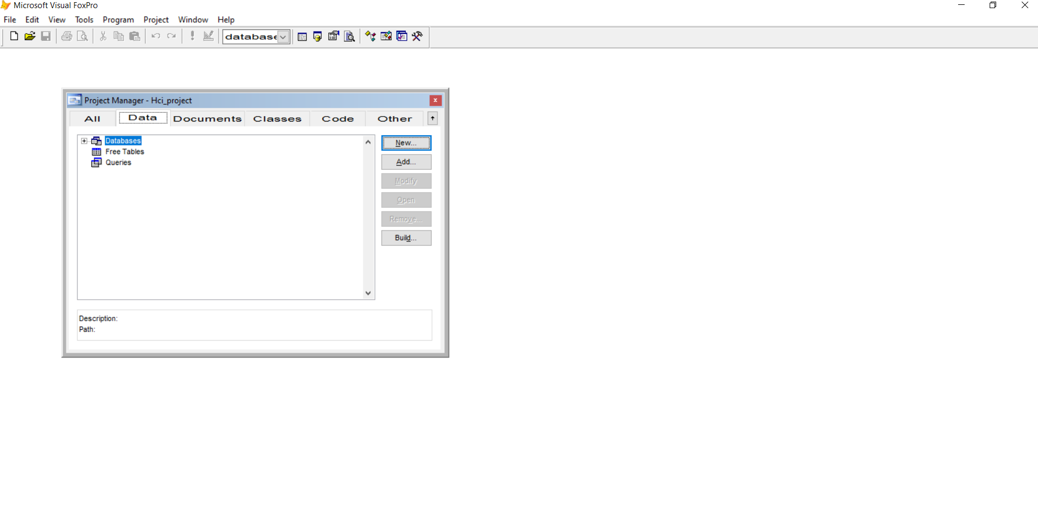
Working Environment
To create a new database we have to go to the "Data" tab and select the "Databases" option

Slide 10
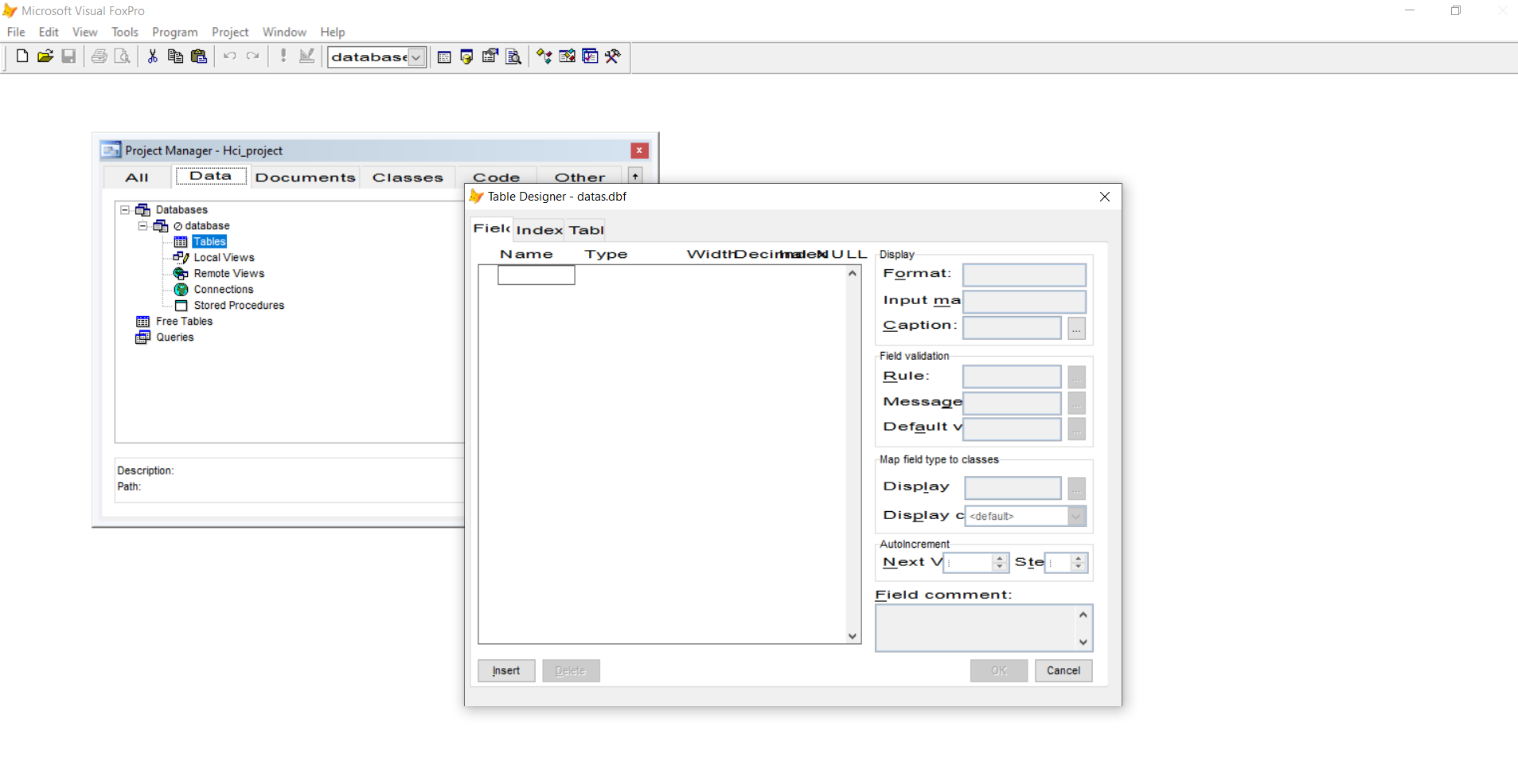
Working Environment
In this field, we can create our fields, assign the data type and, if desired, the 'NULL' option.

Slide 11
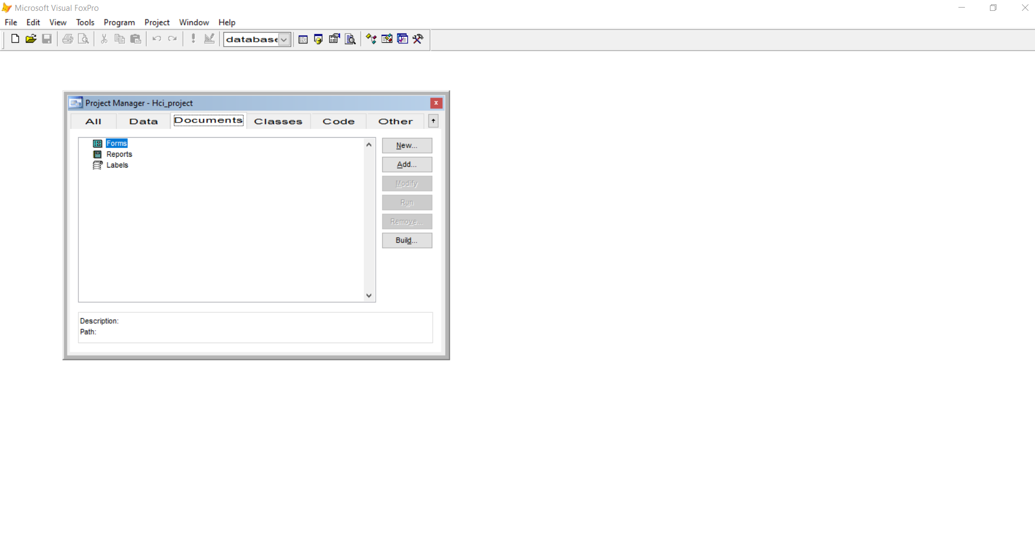
Working Environment
A "Form" that we can create from the "Documents" tab will be required to enter values ​​in the fields.

Slide 12
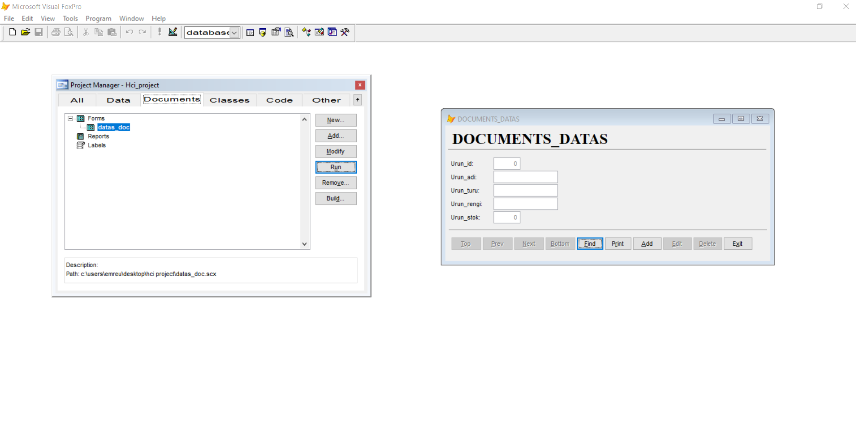
Working Environment
We can interact with our tables by adding, deleting or changing records to the tables via the form.

Slide 13
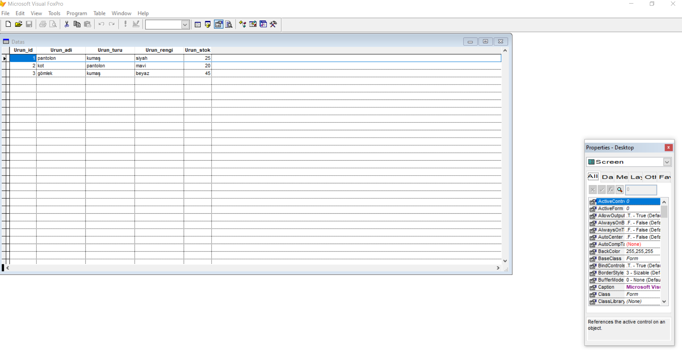
Working Environment
We can observe the records we added by going down to the table details.

Slide 14
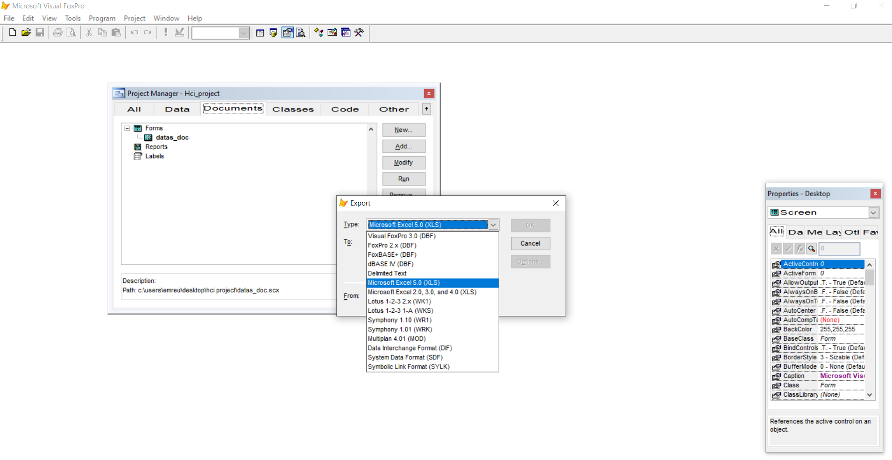
Working Environment
We can ensure that the work we have prepared works on different platforms with the export process.

Slide 15

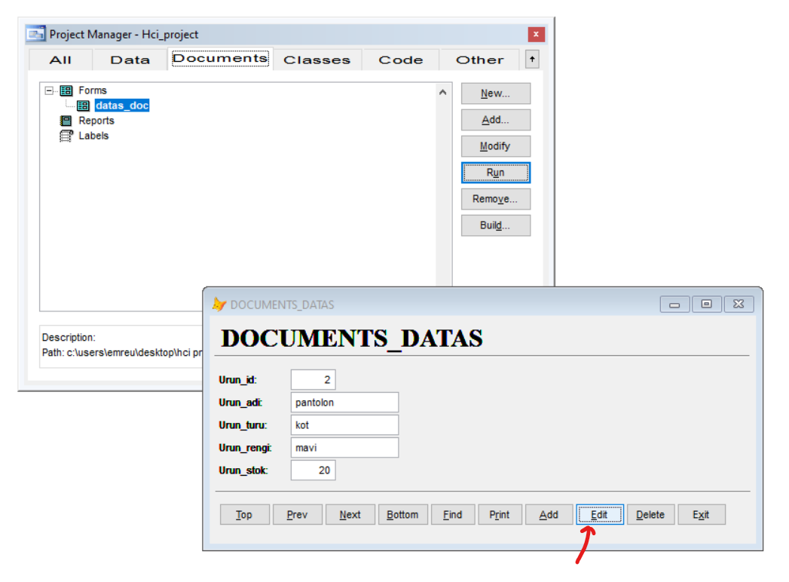
Working Environment
We can update information in the database.

Slide 16
FoxPro and .Net Comparison
There are no strict rules for relational database management.
It is necessary to connect to a different relational Database Management System (RDBMS) with .NET. This causes time wasting as it requires continuous installation.
While FoxPro has built-in rich reporting capability since the DOS era, .NET developers must be dependent on Crystal Reports, SSRS, or other third-party variants.
FoxPro also has .NET capabilities. But it is not dependent on .NET. Therefore, the last executable does not need to have the .NET Framework installed.

Slide 17

THANK YOU FOR LISTENING WITH INTEREST
Emre USTA

